Slide 1



The Greatest Leader
You’ve Never Heard Of
Week 4

Slide 2
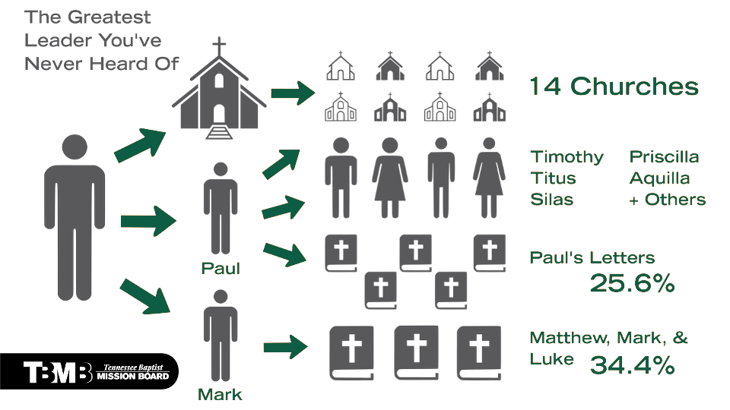

Slide 3
Legend-making leaders are people-lovers.

Slide 4


Slide 5
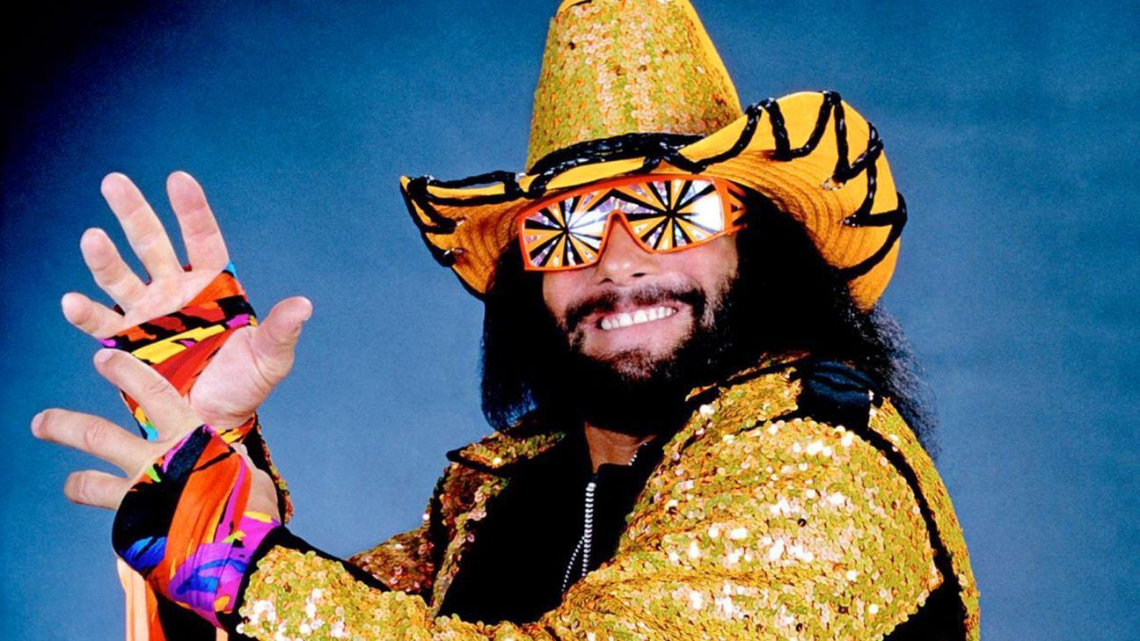

Slide 6
Legend-making leaders are people-lovers.

Slide 7
Legend-making leaders are risk-takers.

Slide 8
Legend-making leaders are grace-revealers.

Slide 9
Legend-making leaders are prominence-pushers.

Slide 10
Legend-making leaders are failure- redeemers.

Slide 11
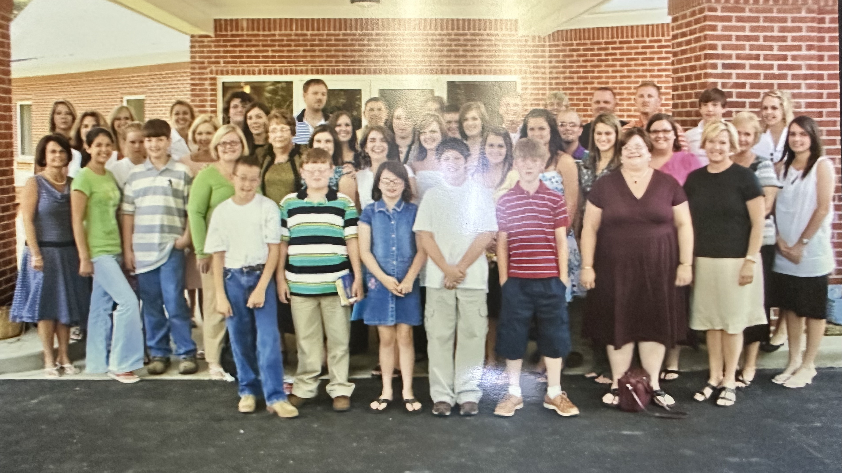

Slide 12
