Slide 1



Lead Like Jesus Pt. 2
Week 3

Slide 2
Your attributes determine your attitudes, and your attitudes drive your actions.

Slide 3
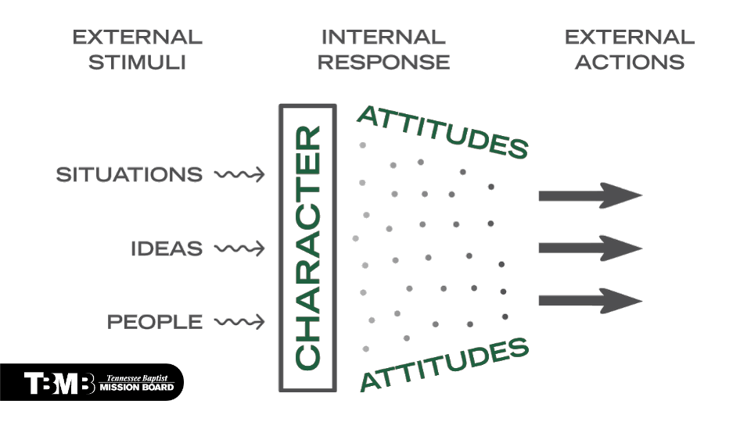

Slide 4
Your attitude, not your aptitude, will determine your altitude.

Slide 5
The attribute of integrity produces an attitude of trustworthiness.

Slide 6
The attribute of humility produces an attitude of servant-heartedness.

Slide 7
The attribute of love produces the attitude of empathy.

Slide 8
The attribute of courage produces the attitude of resilience.

Slide 9
The attribute of perseverance produces the attitude of diligence.

